Slide 1

ISCG 6426 Data Structures and Algorithms Project
Name: Priyam Patel
STUDENT ID: 1512428

Slide 2
Selection of the Data Structure
Singly Linked List

Slide 3
Introduction
Singly linked list is the simplest type of linked list in which every node contains some data and a pointer to the next node of the same data type. The node contains a pointer to the next node means that the node stores the address of the next node in the sequence. A single linked list allows traversal of data only in one way.

Slide 4
IDE used for this Project
Microsoft Visual Studio 2019

Slide 5
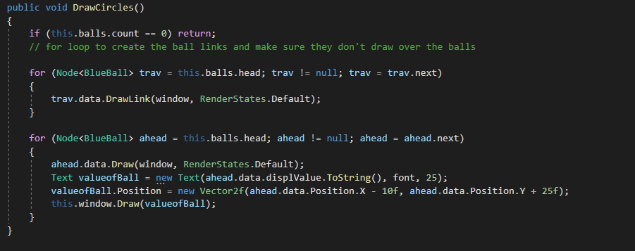
Method to draw the circles and label the values

Slide 6
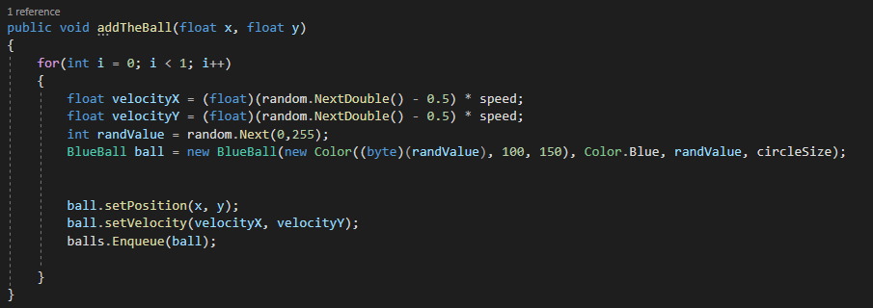
Method to add the balls

Slide 7
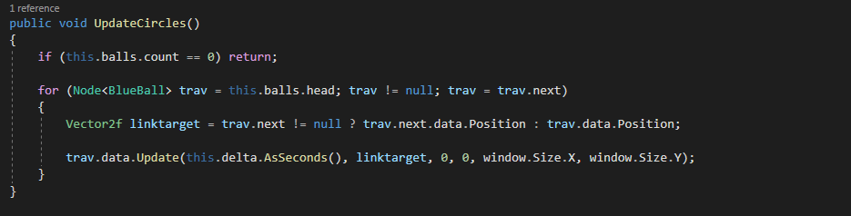
Method to Update the circles

Slide 8
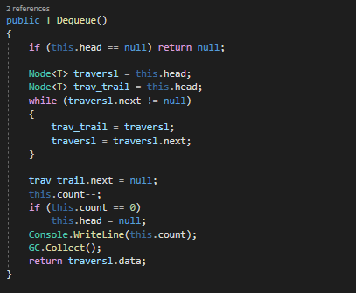
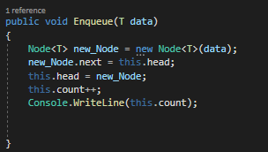
Enqueue and Dequeue Methods

Slide 9
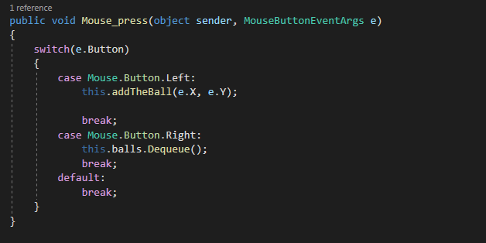
Mouse Press Method

Slide 10
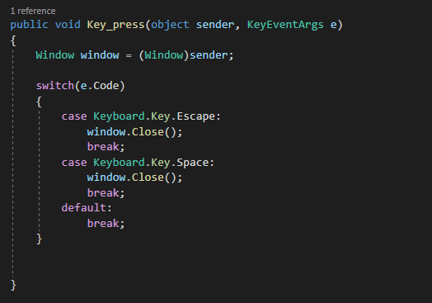
Key Press Method

Slide 11
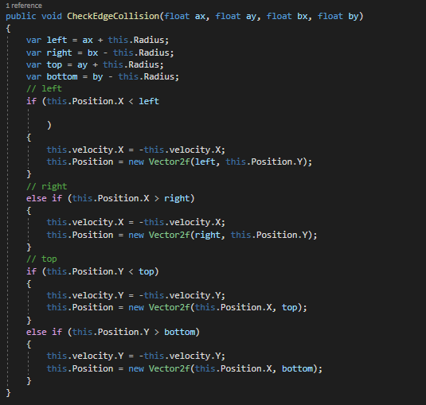
Method to check the edge collision

Slide 12
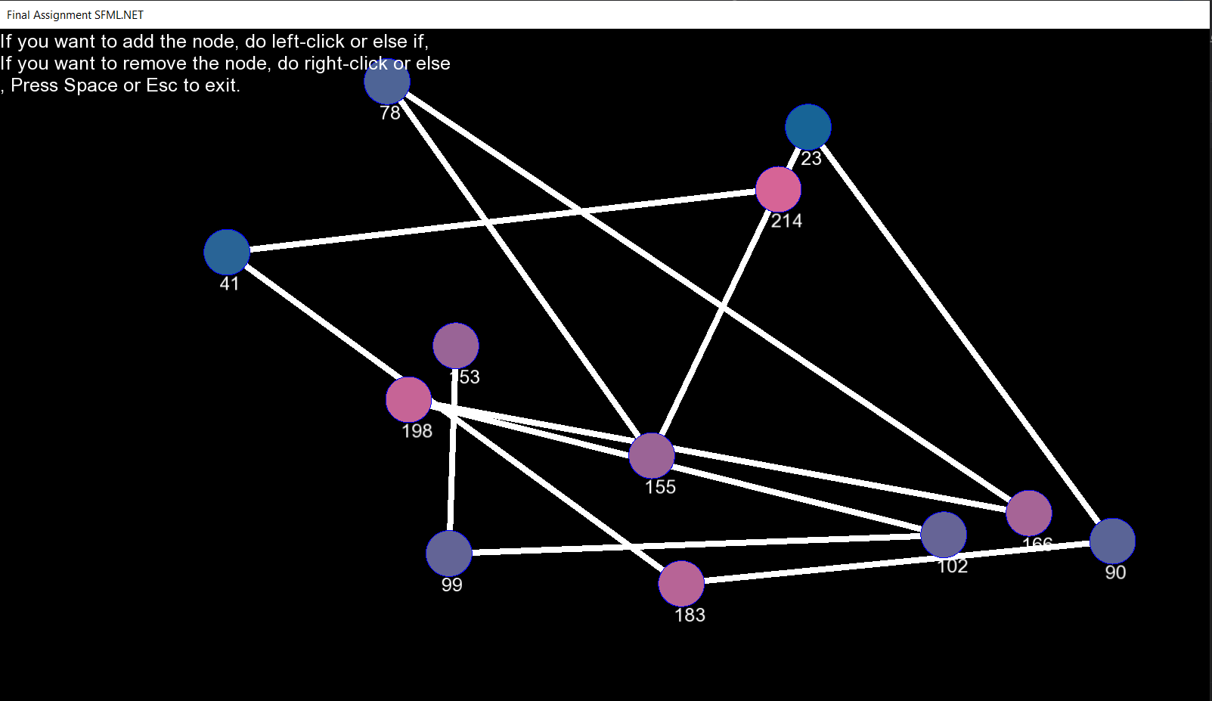
Final Output

Slide 13
ISSUES ENCOUNTERED
Mouse Press and Key Press not working during adding or removing the node and the escape button didn't work.
Faced issues with drawing the circles.
Had problems while labeling the circles with the values.
had issues with the rotation of the balls.

Slide 14

THANK YOU

